Slide 1
Introduction to Adobe Flash and AS3
by TommyX

Slide 2
What is Flash
Adobe Flash is a multimedia and software platform used for creating:
animation
browser games
mobile games
desktop and mobile applications
Most suitable for creating casual 2D games:
Easy to learn and use
Graphical Interface
Easy to distribute

Slide 3
What is ActionScript 3.0
ActionScript 3 is the programming language for the Adobe Flash platform:
Most similar to JavaScript
Intro to programming

Slide 4
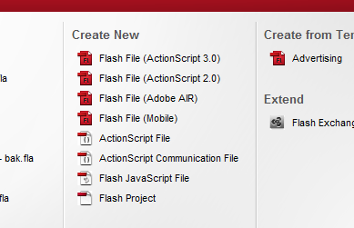
Simple Example
Creating a new file

Slide 5
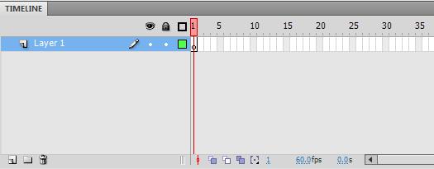
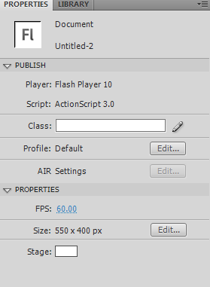
Simple Example
Interface
Timeline:
Used for animation and frame control
Properties:
Change property of selected object.
Can also modify frame rate, background color and window size.

Slide 6
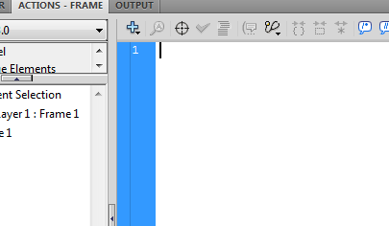
Simple Example
Interface
Actions (hit F9):
Used for entering scripts
Tools:
Variety of tools used in drawing and selecting objects

Slide 7

Simple Example
Drawing a shape
Pick a tool and draw the object on the stage

Slide 8

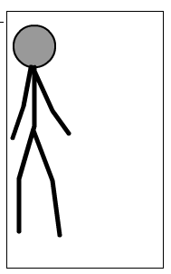
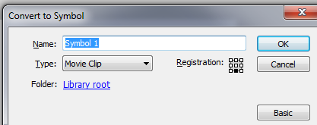
Simple Example
Turning shape into an object
Select the “Select” tool
Drag and select your shape
Hit F8 key:
Name your object,
And hit ‘OK’

Slide 9
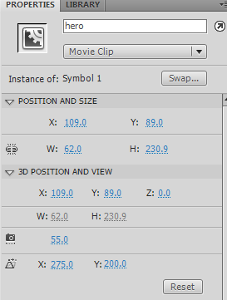
Simple Example
Enter the ‘instance name’ of your object to be used in our code
Give your object an ‘instance name’
Note: each symbol can have multiple copies on the stage, in order to control them, each copy(called instance) needs one distinct instance name.

Slide 10

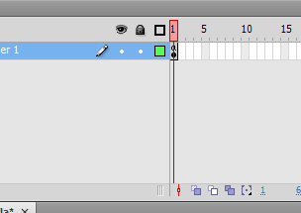
Simple Example
Controlling object with code
Hit F9 key to bring up action panel
Click on the only frame we have to let action panel edit the script for that frame

Slide 11
Simple Example
Controlling object with code
(Use the INSTANCE NAME not the symbol name.)
Example Code:
//the text "//" means this line is a comment and has no effect
//Changing properties of the object on stage
//the 'instance name' of my object is 'hero'
hero.x = 200 //hero's x position is set to 200 (0 being left most of the screen)
hero.y = 100 //hero's y position is set to 100 (0 being top of the screen)
hero.scaleX = 2 //the horizontal scale of hero is set to 2 (1 meaning 100%)
hero.scaleY = 0.5 //the vertical scale of hero is set to 0.5 (half size)
hero.rotation = 20 //hero's rotation is set to 20 degrees (around the origin -- the '+' mark on the object)
hero.alpha = 0.5 //hero's transparency is set to half.

Slide 12
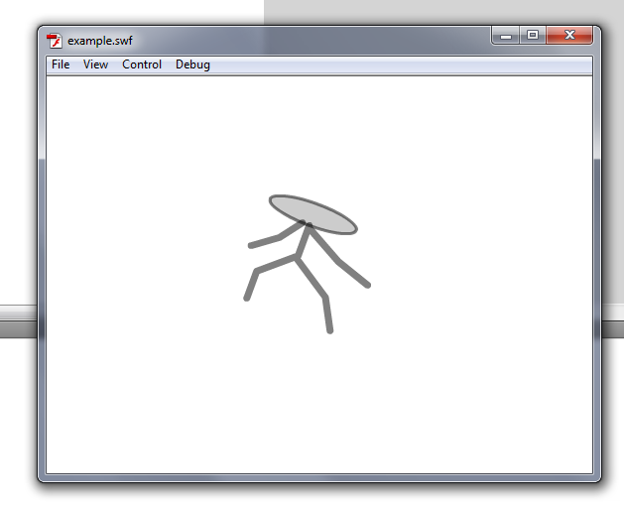
Testing
Testing movie/game
Pressed Ctrl+Enter to test your game.
A .swf file with the same name as your source file will appear under the same folder where you saved your source file.

Slide 13
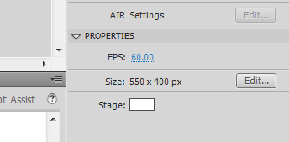
Simple Animation
Objects “move” by changing its position every frame. We will need to execute some code every frame in order to achieve animation.
The below code creates a bunch of code that runs every frame, we will explain all parts of the code in later lessons.
Change your frame rate here. This determines how many frames are went through every second.
Example Code:
function onEnterFrame(event){
hero.rotation += 2 //increase hero's position by 2 each frame (equal to hero.rotation = hero.rotation + 2)
hero.x = mouseX //set hero's x position to mouse cursor's x position
hero.y = mouseY //set hero's y position to mouse cursor's y position
}
addEventListener(Event.ENTER_FRAME, onEnterFrame) //this code notify flash to start running the above code(inside curved bracket) every frame

